Slide 1
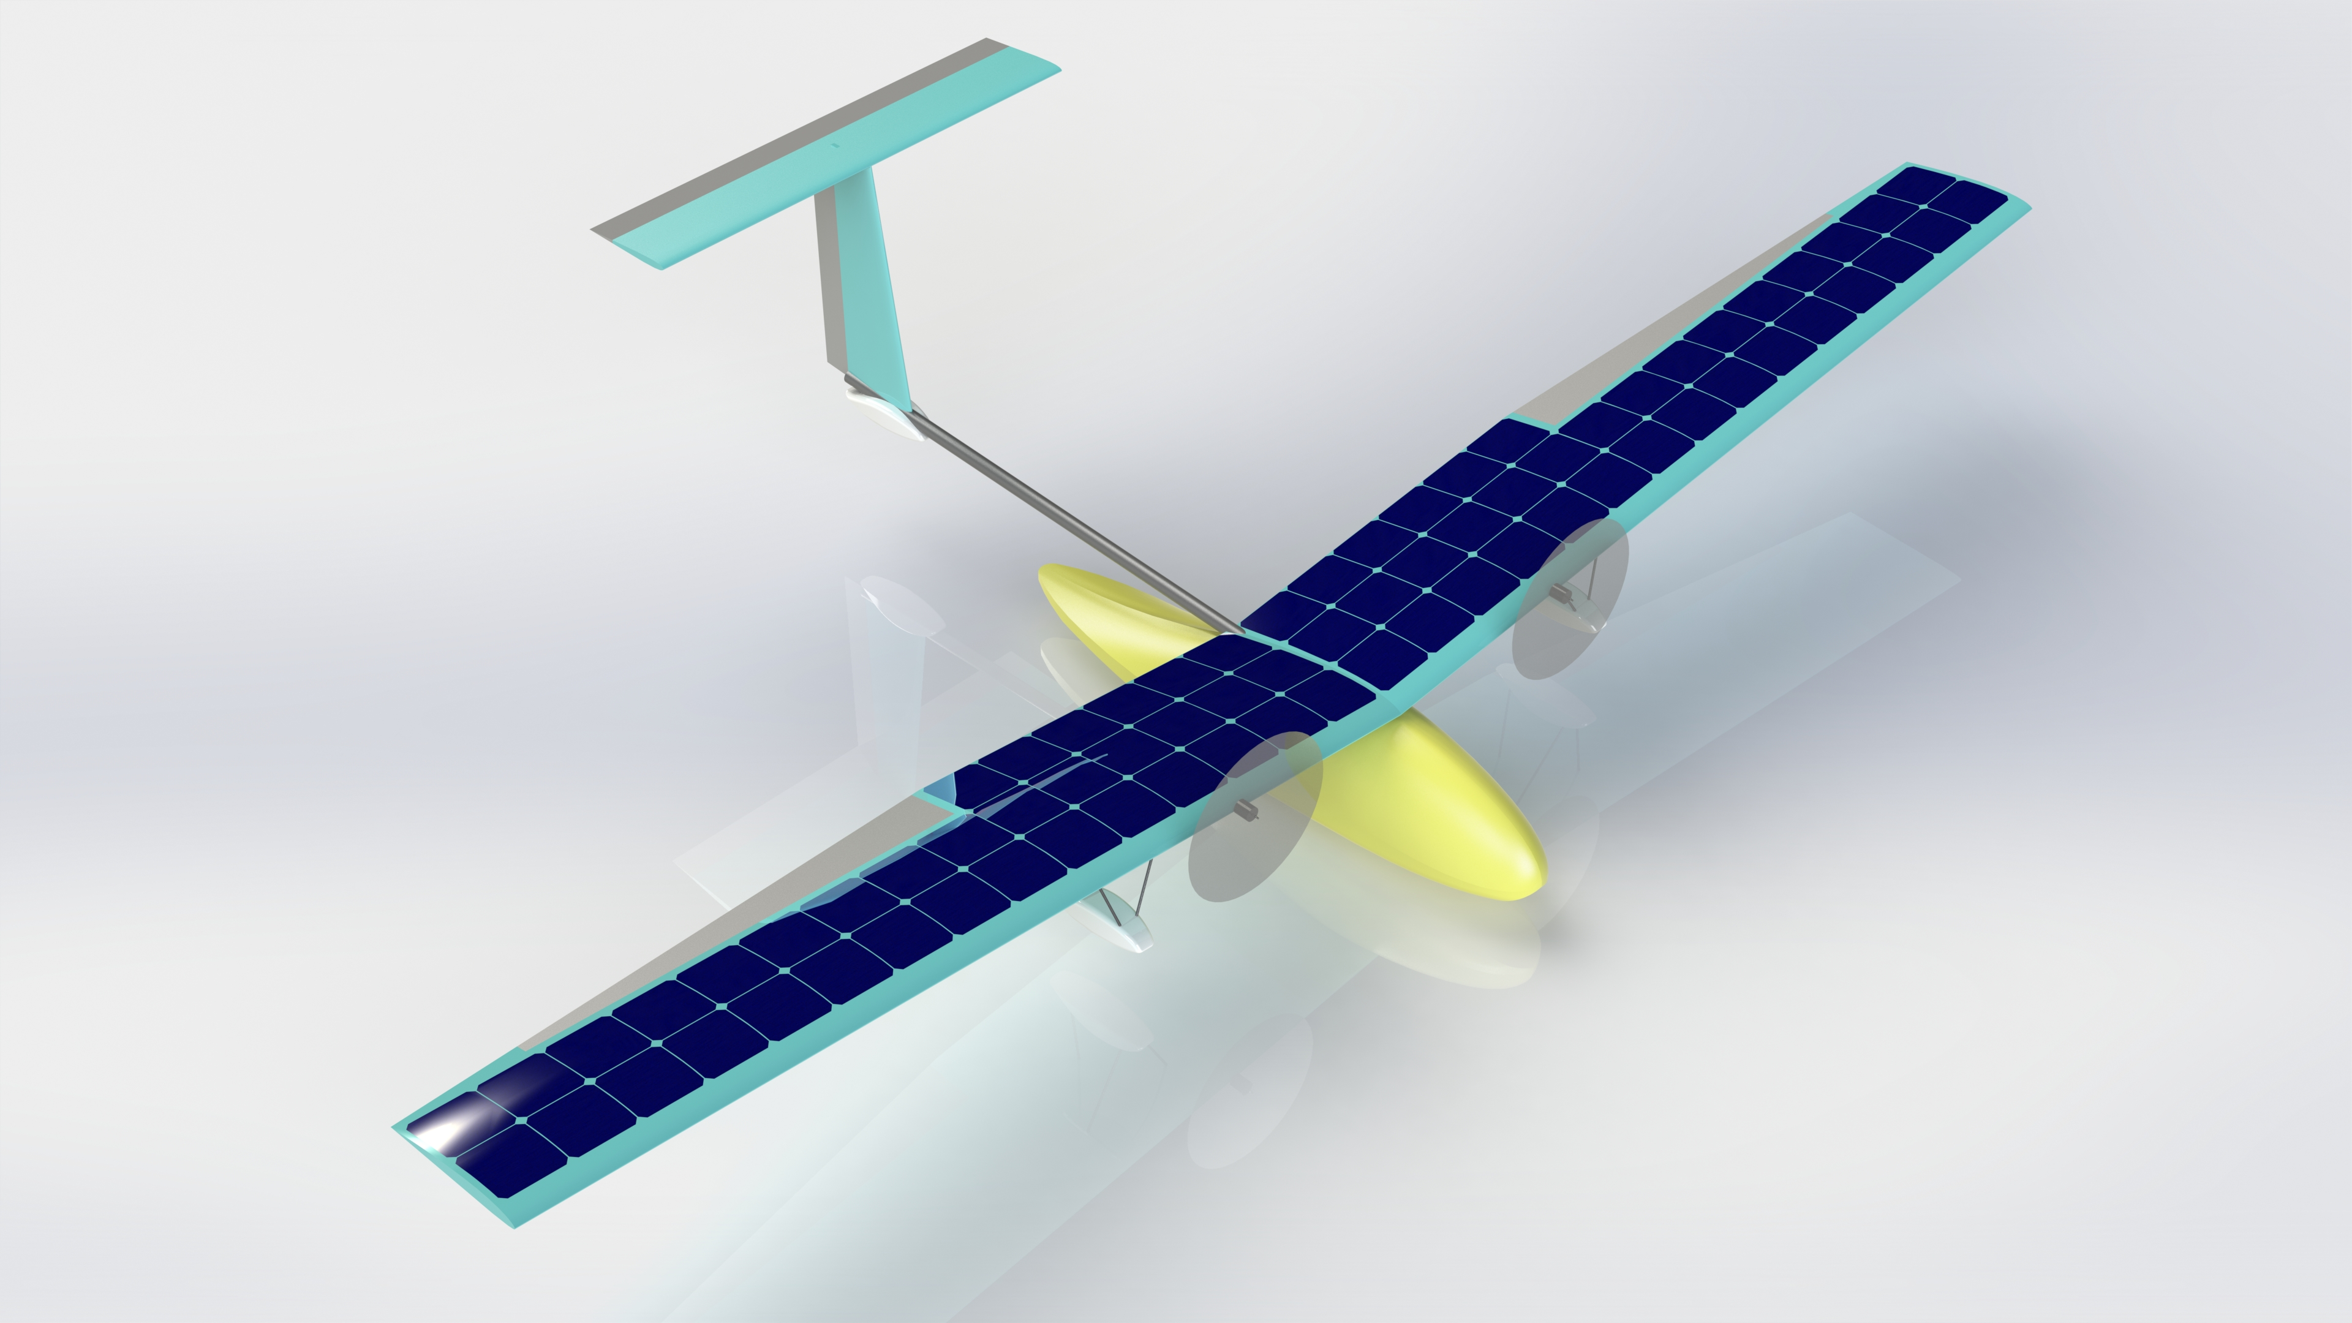
16.821 Point of Departure: Design Overview
Peter Sharpe MIT AeroAstro
Monday, February 6, 2023

Slide 2
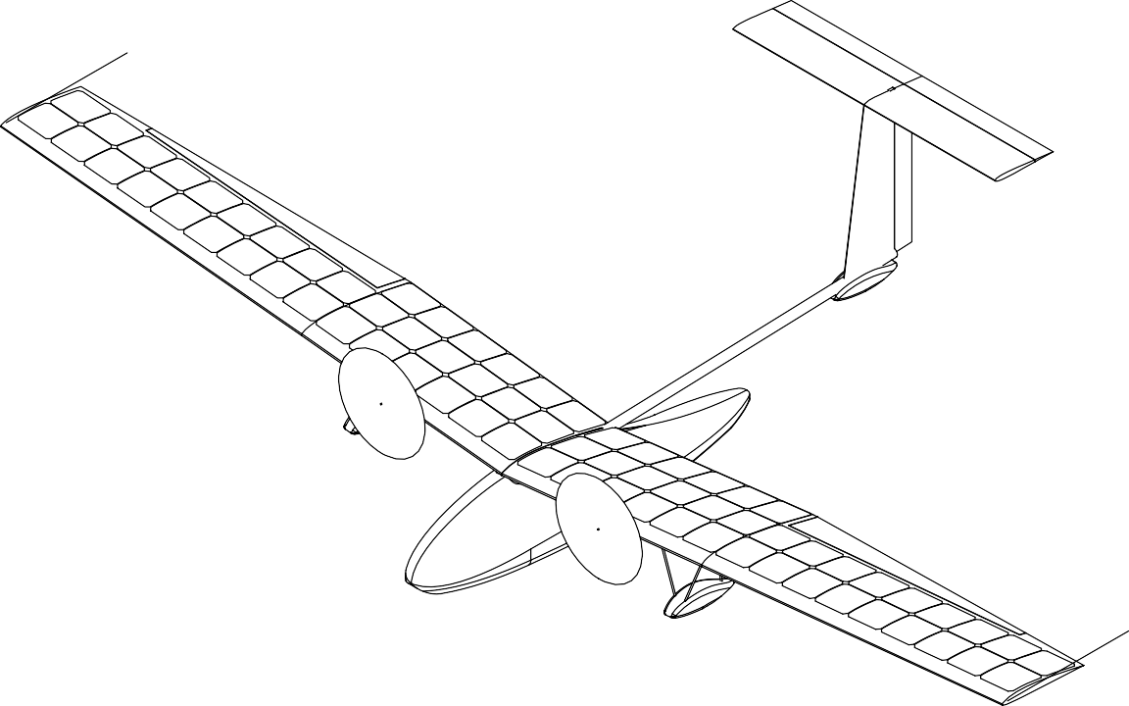

“SEAWAY-Mini” Introduction
Sub-scale solar-powered seaplane
Demonstration goals:
Net-energy-positive solar flight during daytime
Water taxi, takeoff, and landing
Basic figures:
3.825 m
(12.55 ft)
4-section wing
(left/right, in-/out-board)
Wing span | 3.8 m (13 ft)
Mass (TOGW) | 6.6 kg (16 lb)
Cruise airspeed | 9 m/s (21 mph)
Propulsion | 13” props (2x)
Planing hull
Sponsons
Solar cells

Slide 3
Goals of this Conceptual Design Exercise
Serve as a Starting Point
Decompose a Large Problem
Still many of open detailed design decisions to explore – this is almost guaranteed to not be the “final design”
Will need regular updating (e.g., mass properties tracking) to verify closure
Only a starting point - we strongly encourage you to refine the design if the engineering justifies it!
Create subsystem estimates and anticipate failure modes:
SWAP: Size, Weight, and Power
Break up the deadlock (coupling)
Smaller design problems (e.g., tail detail design and hull design) can be worked on in parallel
Allows everyone to be responsible for some part of the airplane

Slide 4
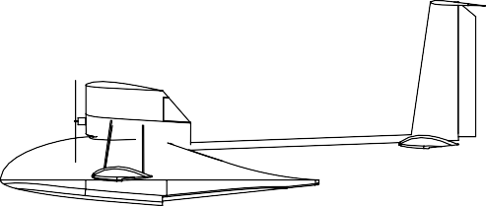
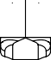



Design Overview: Basic Configuration and Sizing
Dimensions in meters unless specified.
1.386
(13")
0.330
1.308
6°
0.188
0.559
0.828
0.601
0.070
0.228
0.070
0.222
0.260
0.344
0.652
1.281
1.000
0.125
0.125
0.883
Solar cell detail
Solar cell detail
0.310
0.420
1.528
3.825

Slide 5
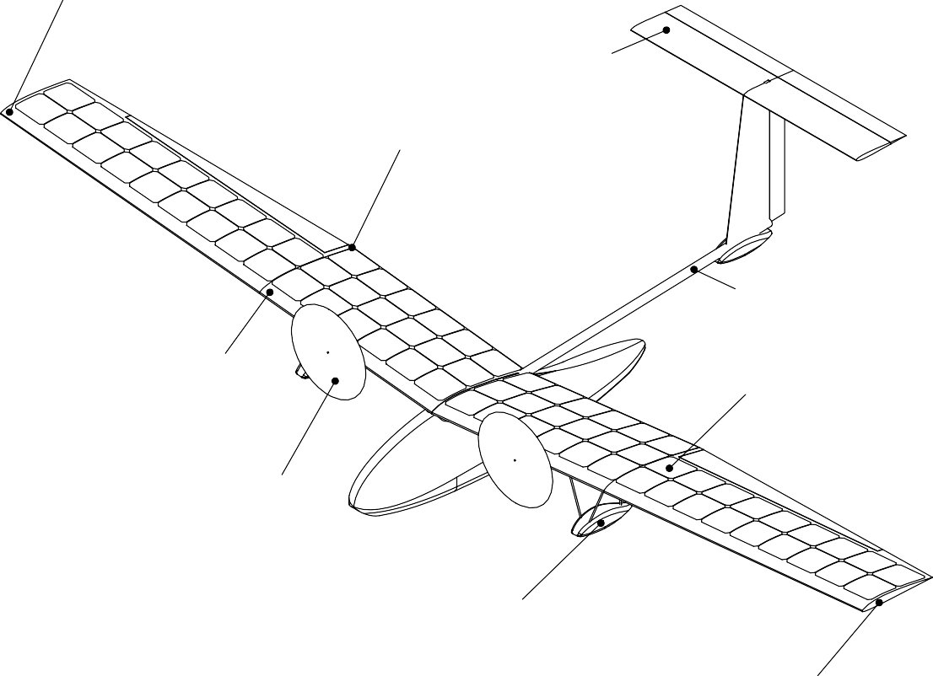
Major Changes from 16.82 SEAWAY
Increased wing incidence to increase takeoff lift, reduce takeoff airspeed
T-tail for water clearance on takeoff rotation
Single-break wing planform increases solar area coverage
Thinner airfoils enable higher solar area coverage (reduced curvature)
Shorter boom to prevent tail-strike on rotation and aeroelastic challenges
Reduced aspect ratio to produce more solar power, optimizing for climb rate
Motors moved inboard to reduce wiring mass
Sponsons moved inboard to reduce yaw moment
on takeoff
Added washout for span efficiency
and handling qualities

Slide 6
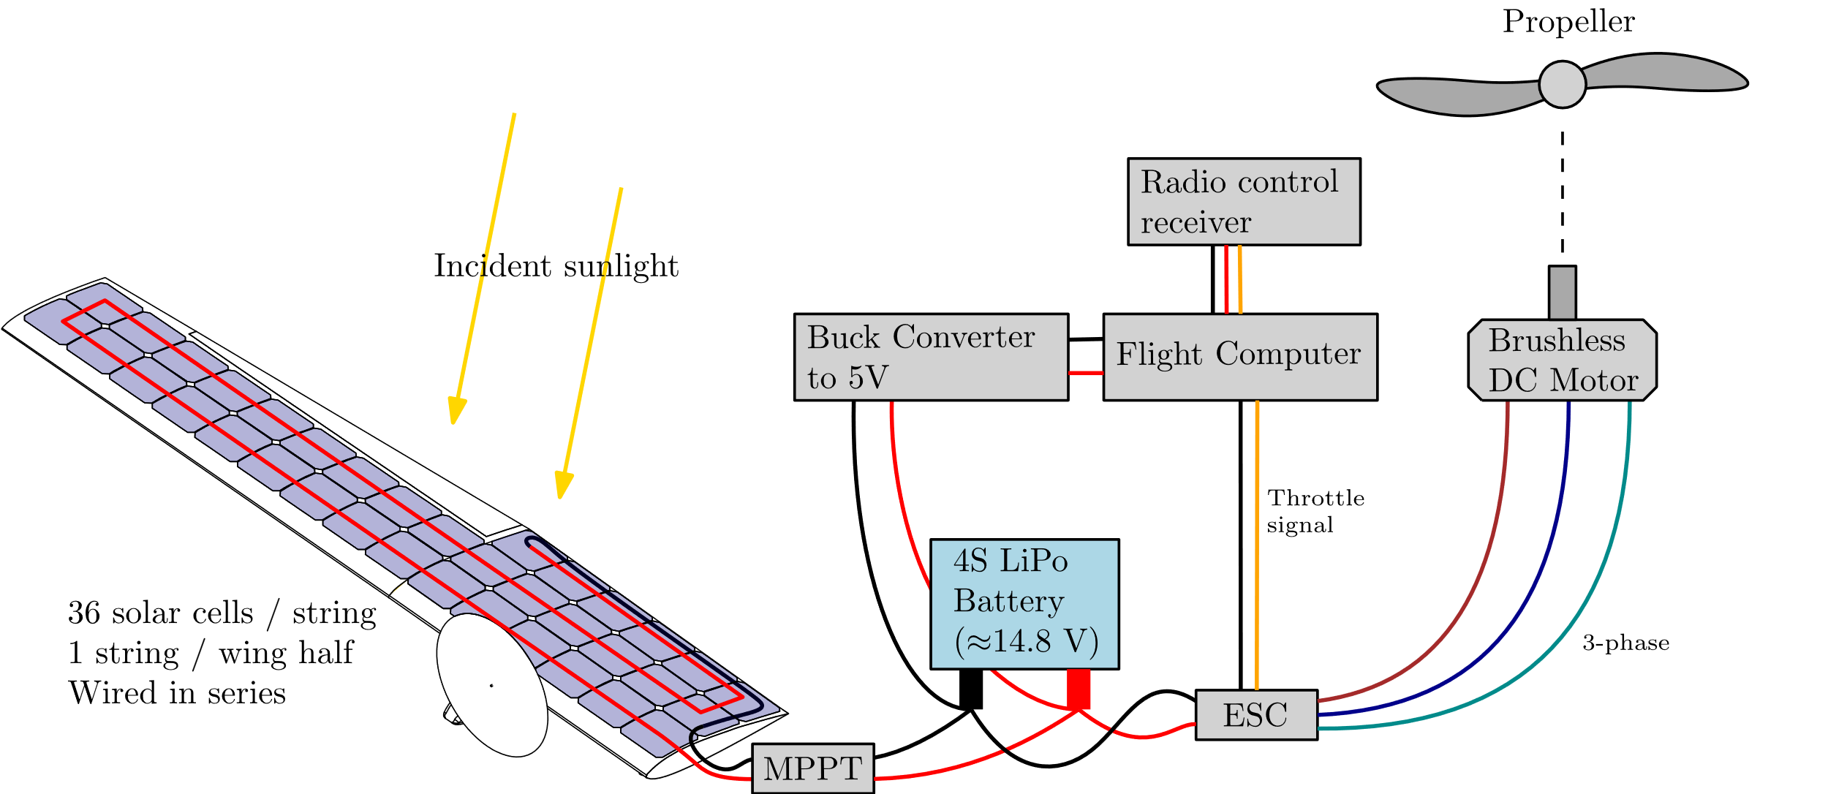
Simplified Circuit Diagram
The following components are doubled left/right:
Solar cell string + MPPT
ESC
Motor
Propeller

Slide 7
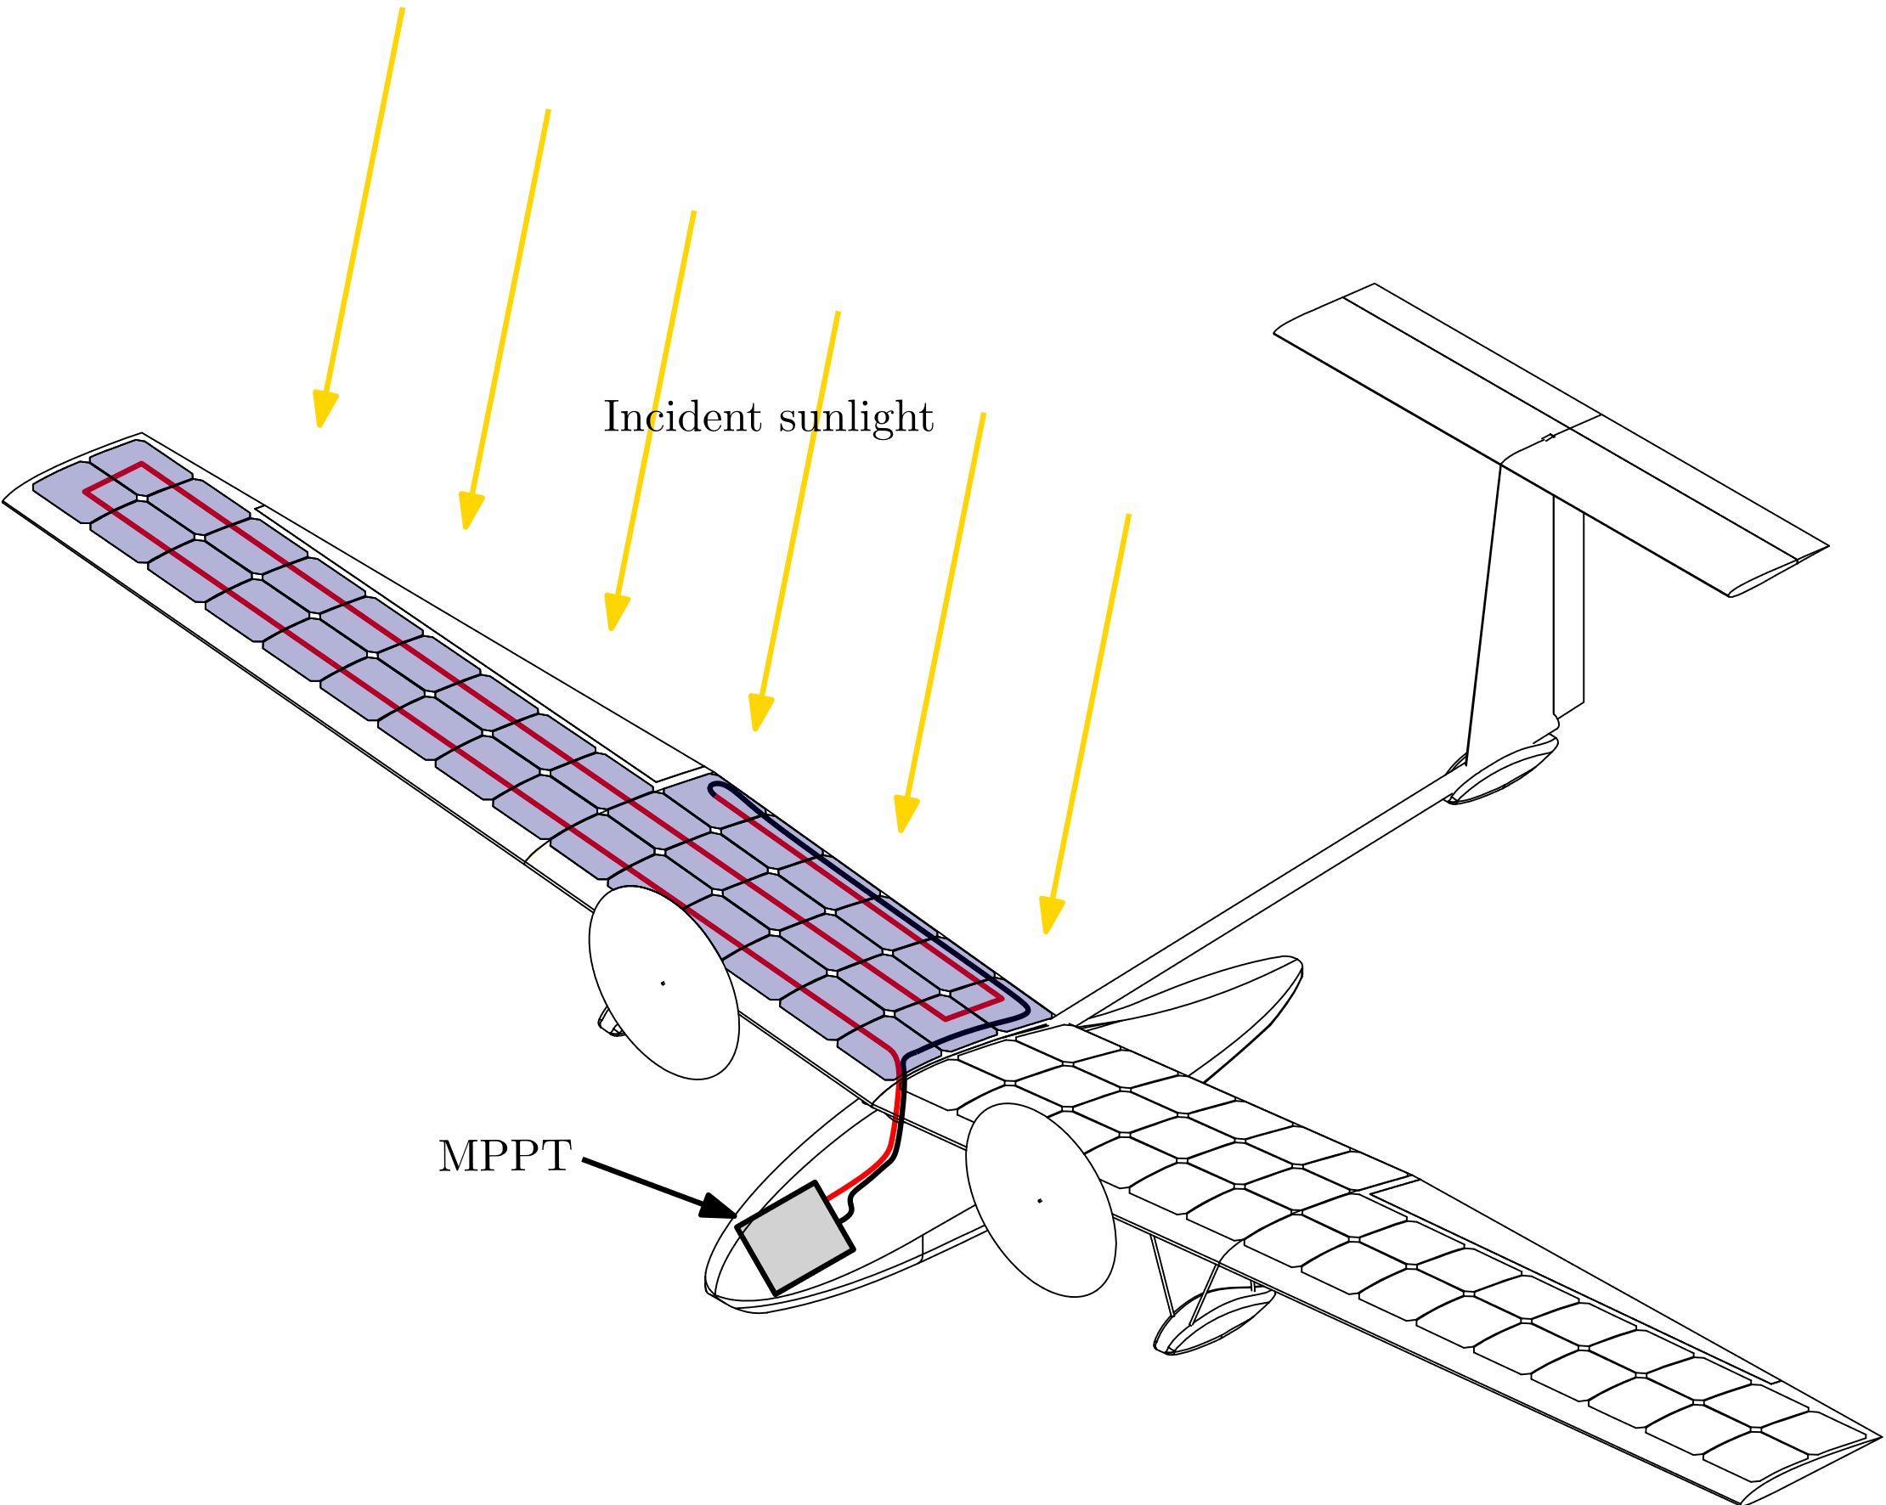
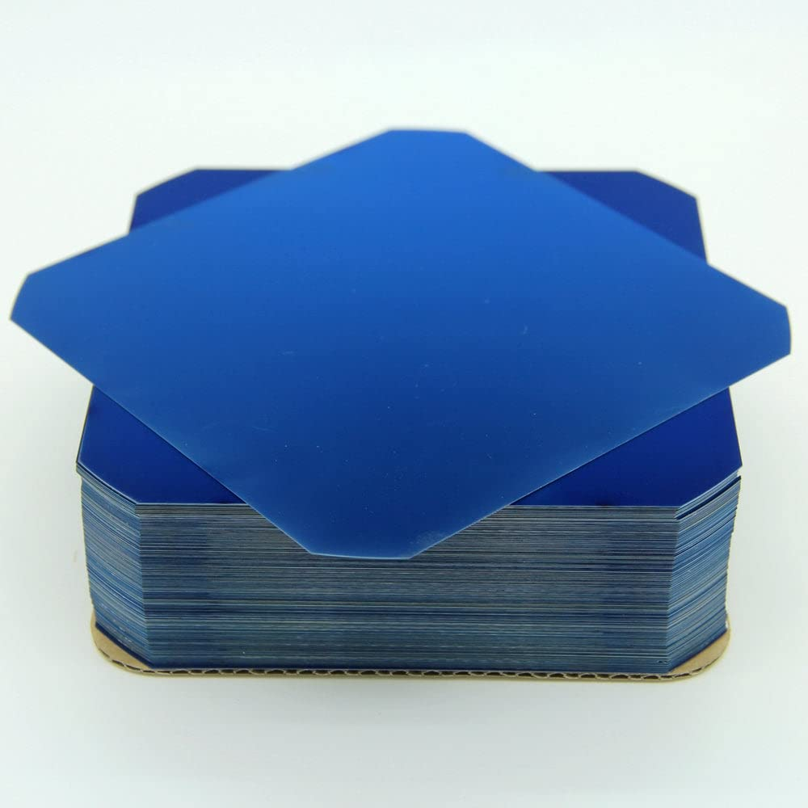
Solar Circuit: Cells
Solar cells:
2 strings, 36 cells/string
Sunpower C60 cells
Flexible, lightweight, reasonably efficient
Discrete choices limit design space (e.g., 2 or 3 chordwise panels?)

Slide 8
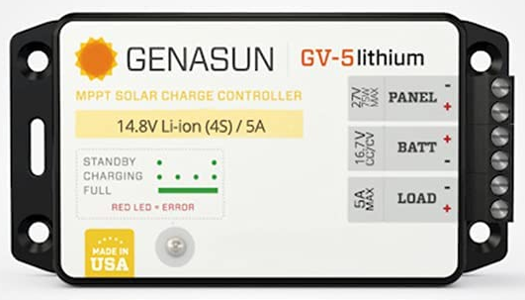
Solar Circuit: MPPT
MPPT: Genasun GV-5-Li
Extremely light (80 grams) - almost no other viable COTS choices at this weight scale
Downside: Input voltage must be within a fairly tight range, which sets the cell count
Discrete choices limit design space (e.g., 36, 72, or 108 total cells?)

Slide 9
Power Budget
Generation (Boston, April 1, 2 p.m.)
Consumption (Cruise)
75 W total (cruise)
67 W total propulsion
8 W Avionics
41 W power to airstream
50 W power to motor
165 W Total after MPPTs
172 W after panels (22%)
785 W solar irradiance

Slide 10
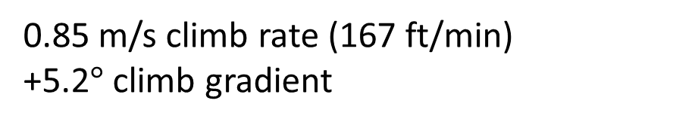
Power Budget
165 W generated after MPPTs (Boston, April 1, 2 p.m.)
75 W consumed (cruise)
90 W excess power (climb)
13 W/kg specific excess power
Takeaway:
Maximizing solar panel area is really important
0.85 m/s climb rate (167 ft/min)
+5.2$°$ climb gradient

Slide 11
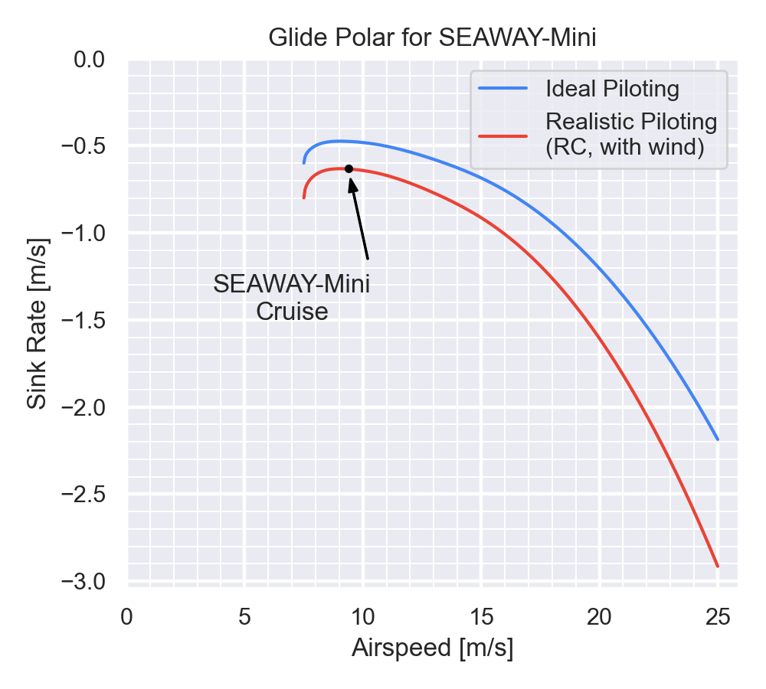
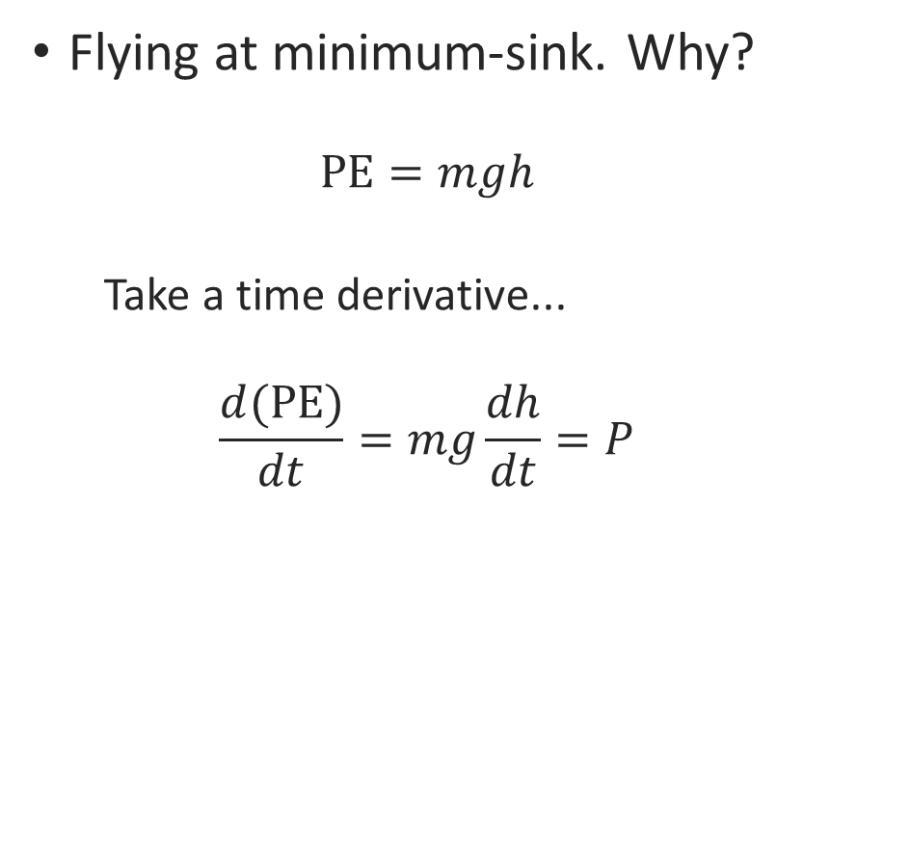
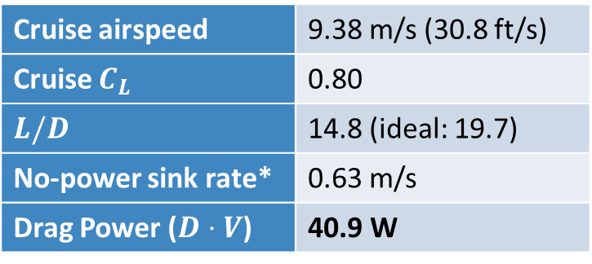
Aerodynamic Performance
Flying at minimum-sink. Why?
$$\text{PE}=mgh$$
Take a time derivative...
$$\frac{d(\text{PE})}{dt}=mg\frac{dh}{dt}=P$$
Cruise airspeed | 9.38 m/s (30.8 ft/s)
Cruise $C_{L}$ | 0.80
$L/D$ | 14.8 (ideal: 19.7)
No-power sink rate* | 0.63 m/s
Drag Power ($D⋅V$) | 40.9 W
*ignores propeller drag

Slide 12
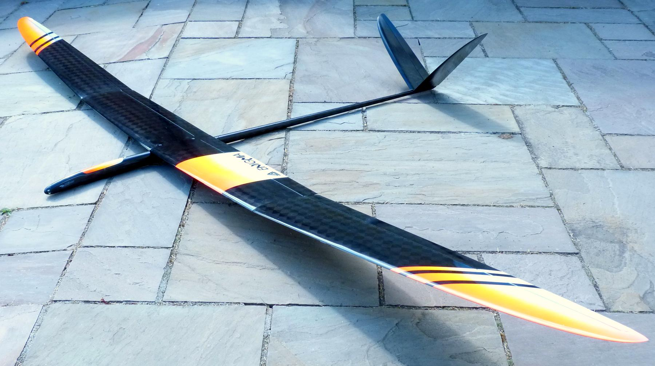
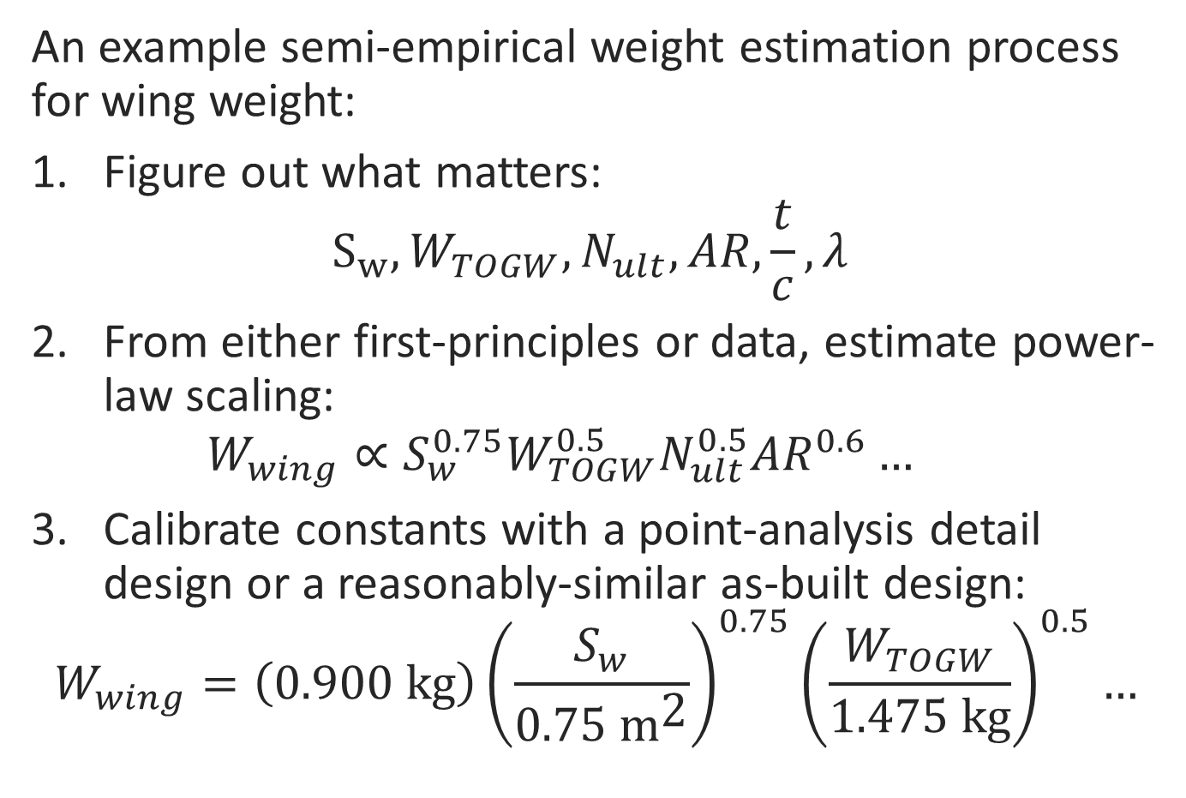
Weights
Weights primarily estimated with semi-empirical models
An example semi-empirical weight estimation process for wing weight:
Figure out what matters: $S_{w}, W_{TOGW}, N_{ult}, AR,\frac{t}{c}, λ$
From either first-principles or data, estimate power-law scaling: $W_{wing}∝S_{w}^{0.75}W_{TOGW}^{0.5}N_{ult}^{0.5}AR^{0.6}…$
Calibrate constants with a point-analysis detail design or a reasonably-similar as-built design:
$$W_{wing}=\left(0.900 \text{kg}\right){\left(\frac{S_{w}}{0.75 {\text{m}}^{\text{2}}}\right)}^{0.75}{\left(\frac{W_{TOGW}}{1.475 \text{kg}}\right)}^{0.5}…$$
Enigma F5J motor-glider “linearization” target

Slide 13
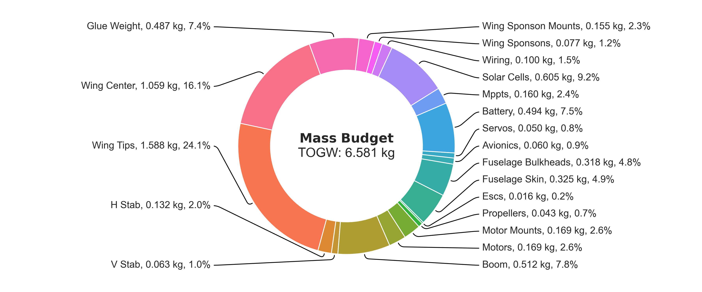
Weights
Structures: 71%
Propulsion: 27%
Fixed: 2%

Slide 14
Design Process Used

Slide 15
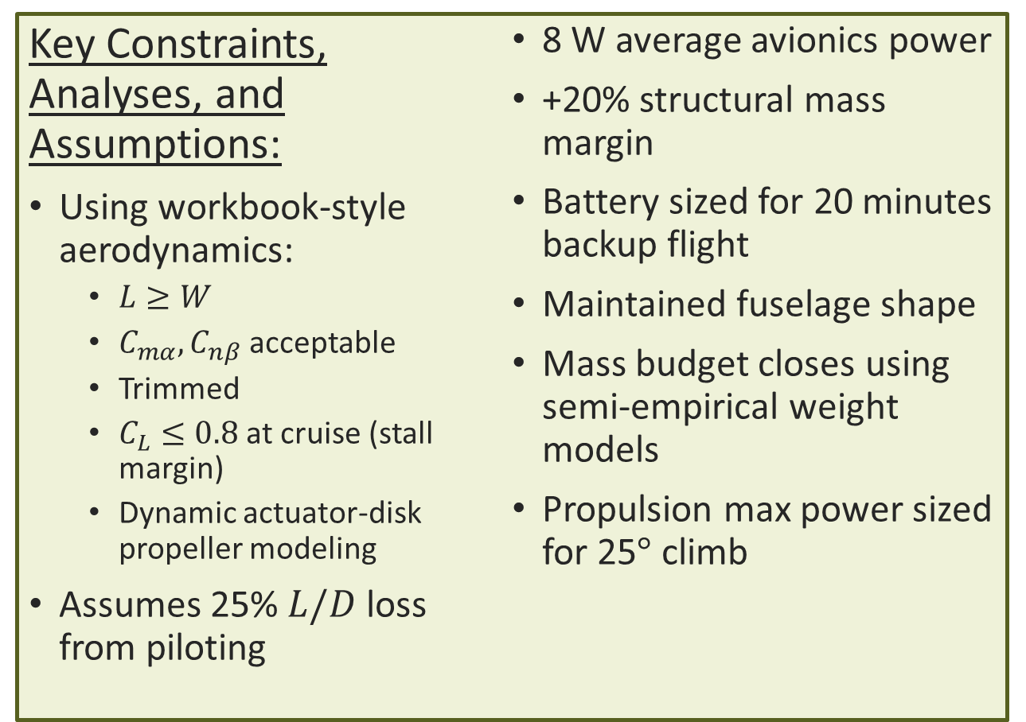
Main Design Optimization Script
Objective:
Maximize the specific excess energy (W/kg) when cruising at:
Boston, April 1, 2 p.m. solar time
Key Constraints, Analyses, and Assumptions:
Using workbook-style aerodynamics:
$L≥W$
$C_{mα}, C_{nβ}$ acceptable
Trimmed
$C_{L}≤0.8$ at cruise (stall margin)
Dynamic actuator-disk propeller modeling
Assumes 25% $L/D$ loss from piloting
8 W average avionics power
+20% structural mass margin
Battery sized for 20 minutes backup flight
Maintained fuselage shape
Mass budget closes using semi-empirical weight models
Propulsion max power sized for 25$°$ climb
Variables:
Panel layout, most parts of the airplane geometry
Propulsion sizing
Cruise flight parameters (airspeed, AoA)

Slide 16
Main Design Optimization Script
Can do point designs, like what we’ve seen:
Can also explore the design space:
Number of Chordwise Panels
In Center (3 here)
Wing Span
(3.8 m)

Slide 17
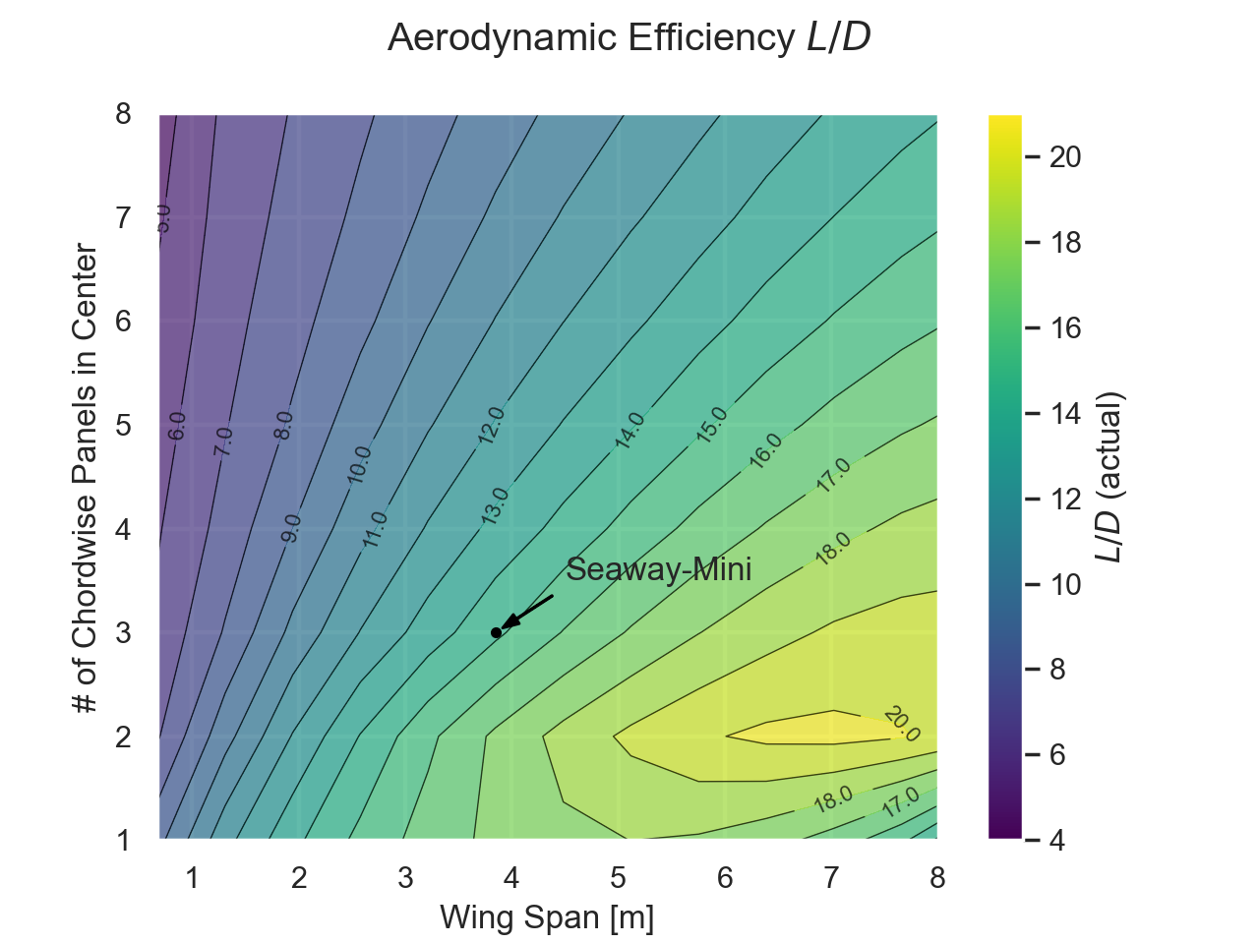
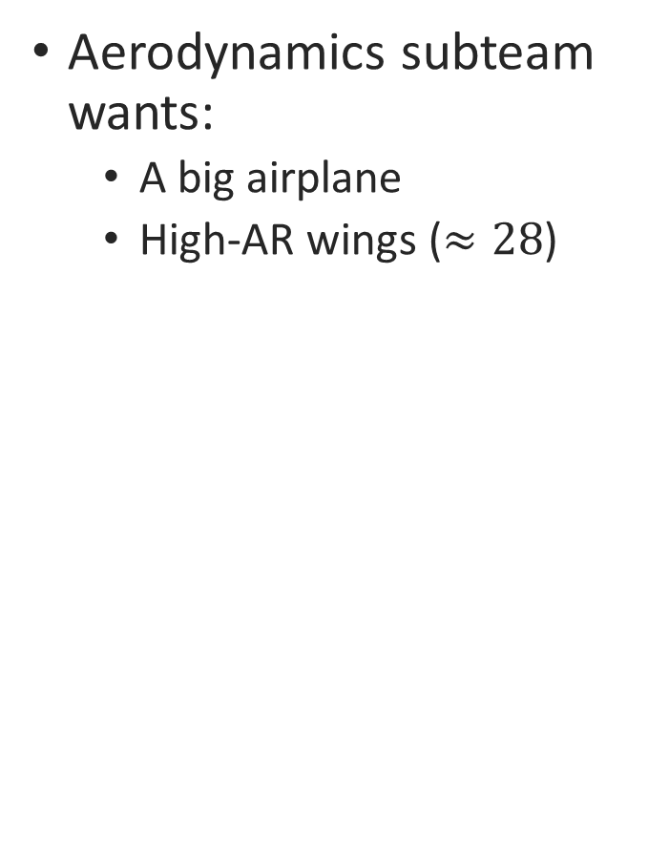
Design Drivers: Aerodynamics
Aerodynamics subteam wants:
A big airplane
High-AR wings ($≈28$)
Number of Chordwise Panels In Center
Wing Span

Slide 18
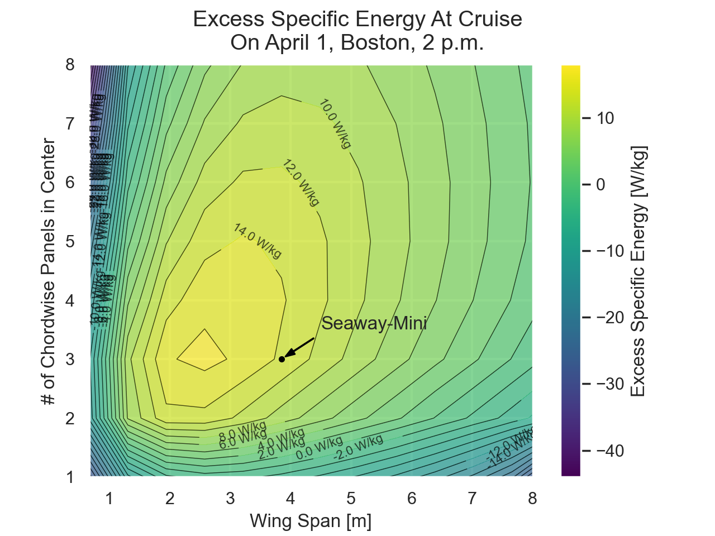
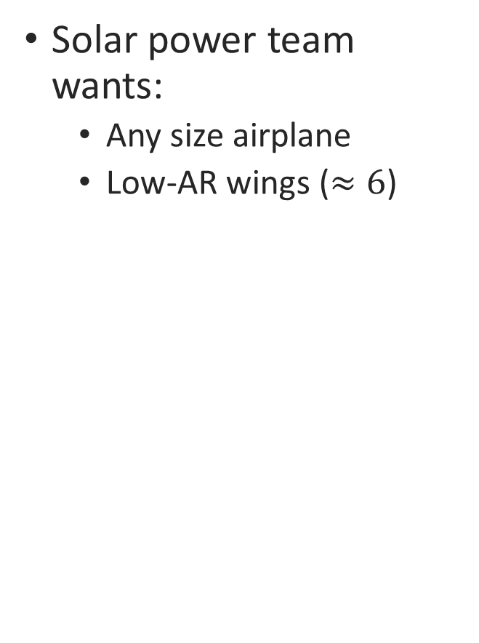
Design Drivers: Solar Power
Solar power team wants:
Any size airplane
Low-AR wings ($≈6$)
Number of Chordwise Panels In Center
Wing Span

Slide 19
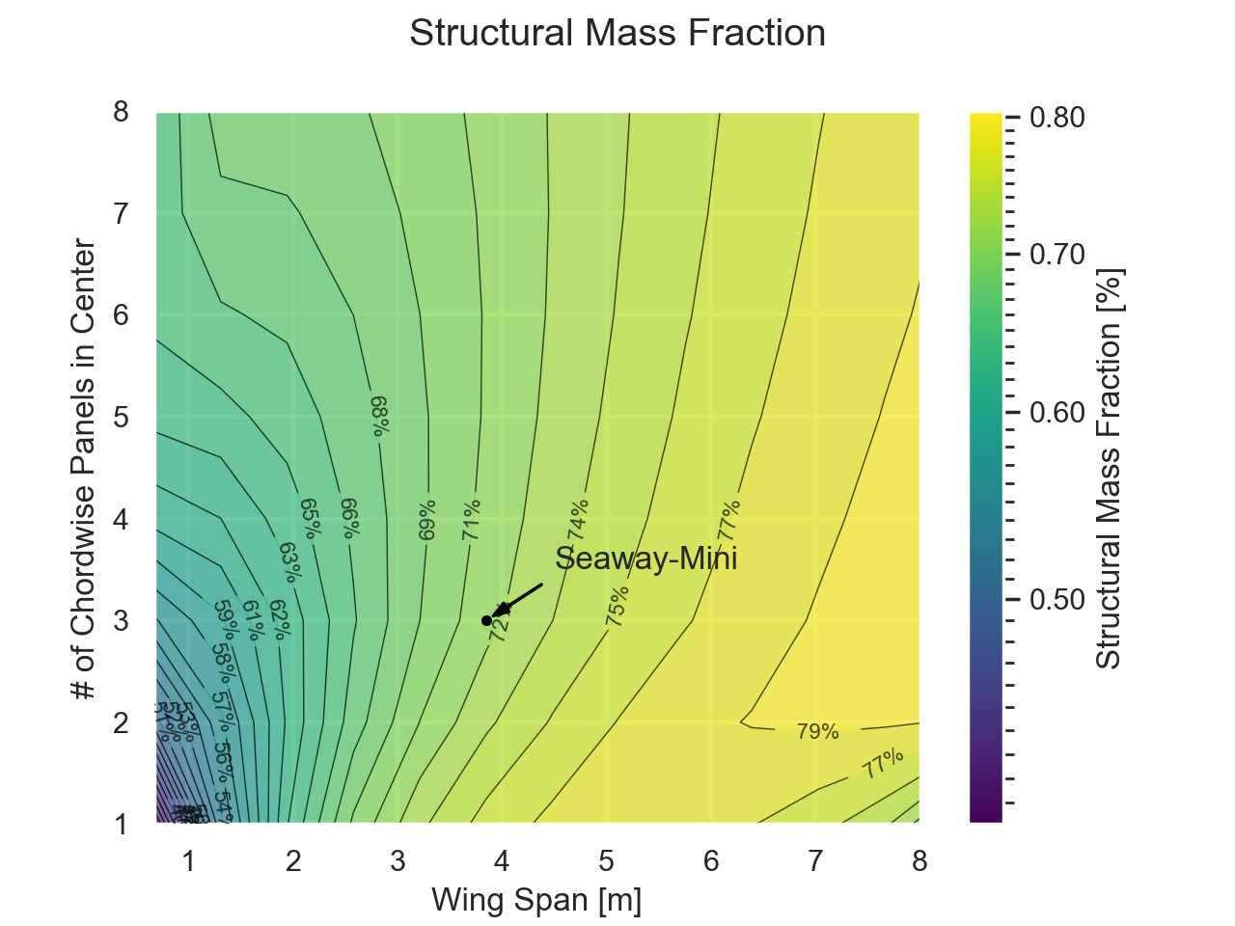
Design Drivers: Structures
Structures team wants:
A small airplane; in particular, low wingspan
Low-AR wings
Number of Chordwise Panels In Center
Wing Span

Slide 20
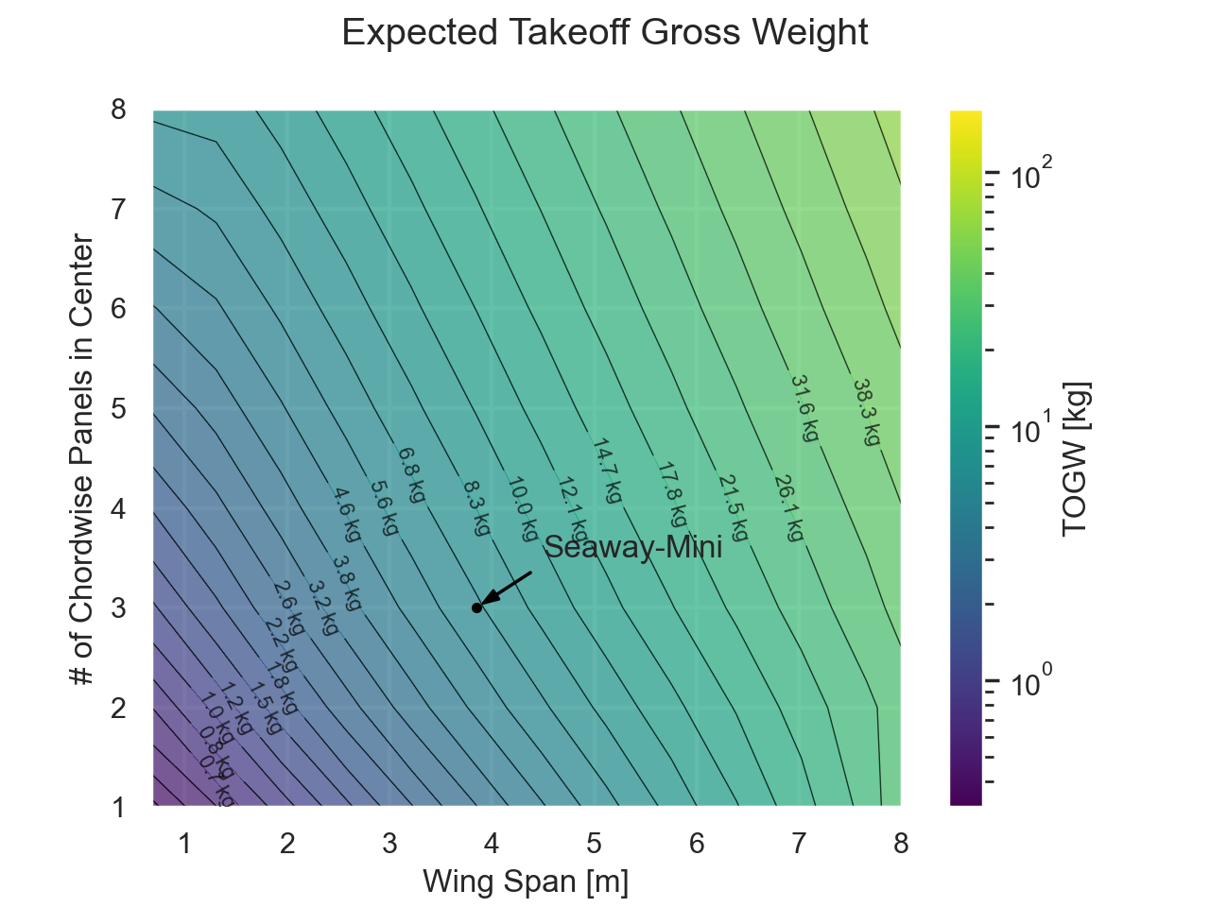
Design Drivers: Weight
Structures team wants:
A small airplane; in particular, low wingspan
Low-AR wings
Number of Chordwise Panels In Center
Wing Span

Slide 21
Still lots of Open Trades and Questions…
Wing manufacturing technique – foam-core or built-up?
Can the sponson mounts be designed for less drag?
Is differential thrust enough for water maneuvering, or is a water rudder needed?
What does the spar-to-hull load path look like?
Where can we improve powertrain efficiency?
How low can avionics and servo power be kept? (e.g., holding torque)

Slide 22
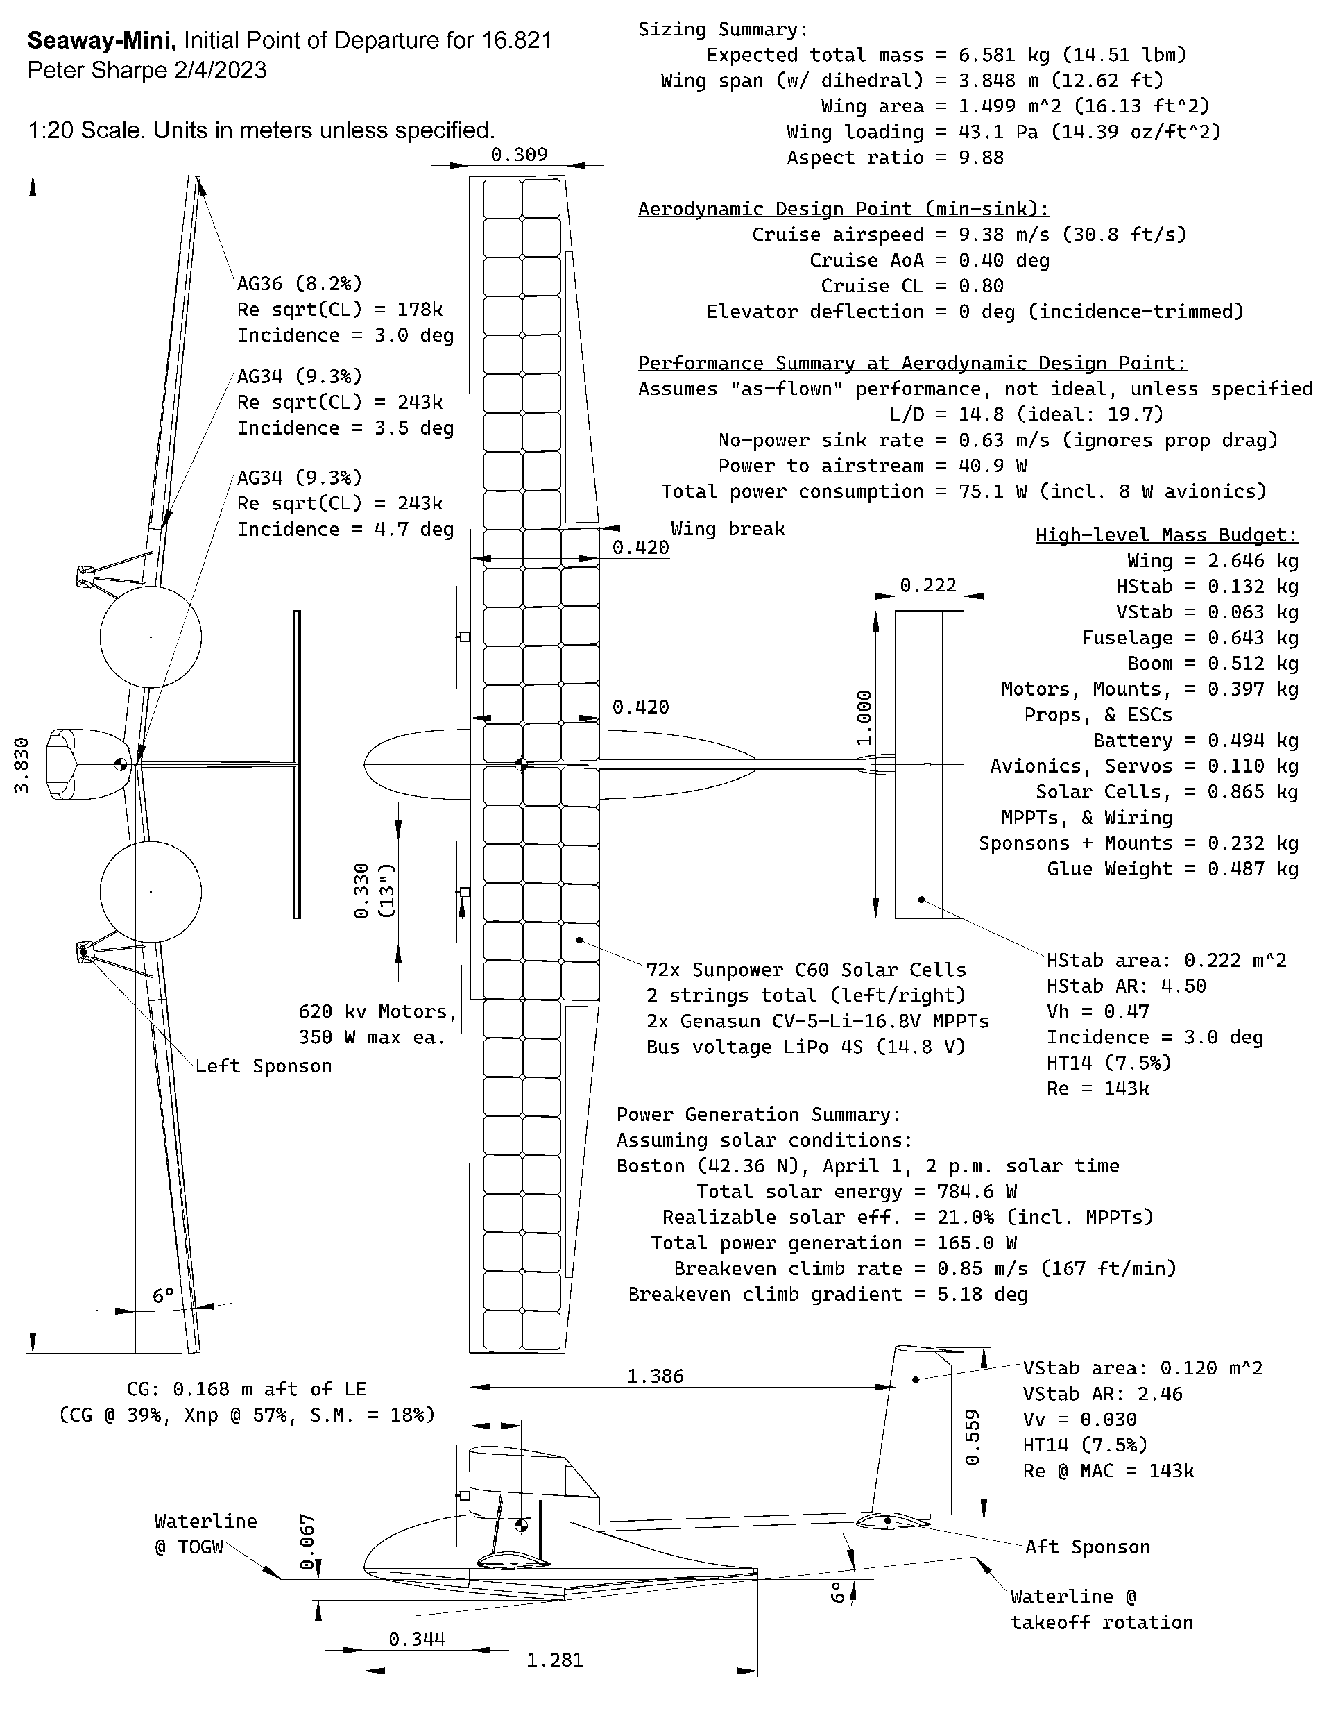
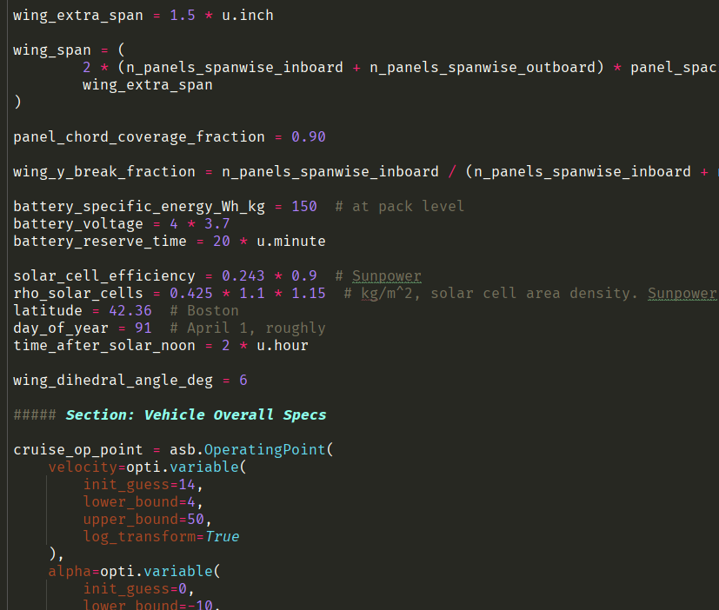
As Seen on Canvas™
All of the files used to design this initial point of departure:
Design Code (Python)
Comes with install guide
Run your own scenarios and trade studies
Most precise way to see all the methodologies + assumptions used
Design Packet (PDF)
A conceptual design packet with dimensions + key SWaP figures
CAD (SolidWorks, Ipe, XFLR5)
A possible starting point for detail design work
Negotiate team interfaces

Slide 23
Next Steps
Comms:
Slack: http://mit-16821-sp23.slack.com/
Canvas: https://canvas.mit.edu/courses/18474
If you have access issues, let me or Julia know
Also, feel free to read through some prior build logs:
In 16.821 Canvas -> Modules -> Prior Solar-UAV builds
Some worked, some didn’t work
All have good lessons to learn, and most are pretty entertaining

